Slide 1
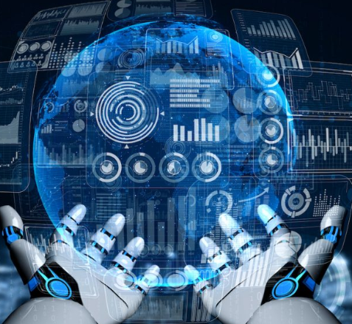
Arsenic Skin Detection Using Machine Learning
CSE 499B: Project Proposal
Ashraful Islam (2212669042) , Tanushree Das (2212225042), Section:15
Gorup:07
North South University

Slide 2
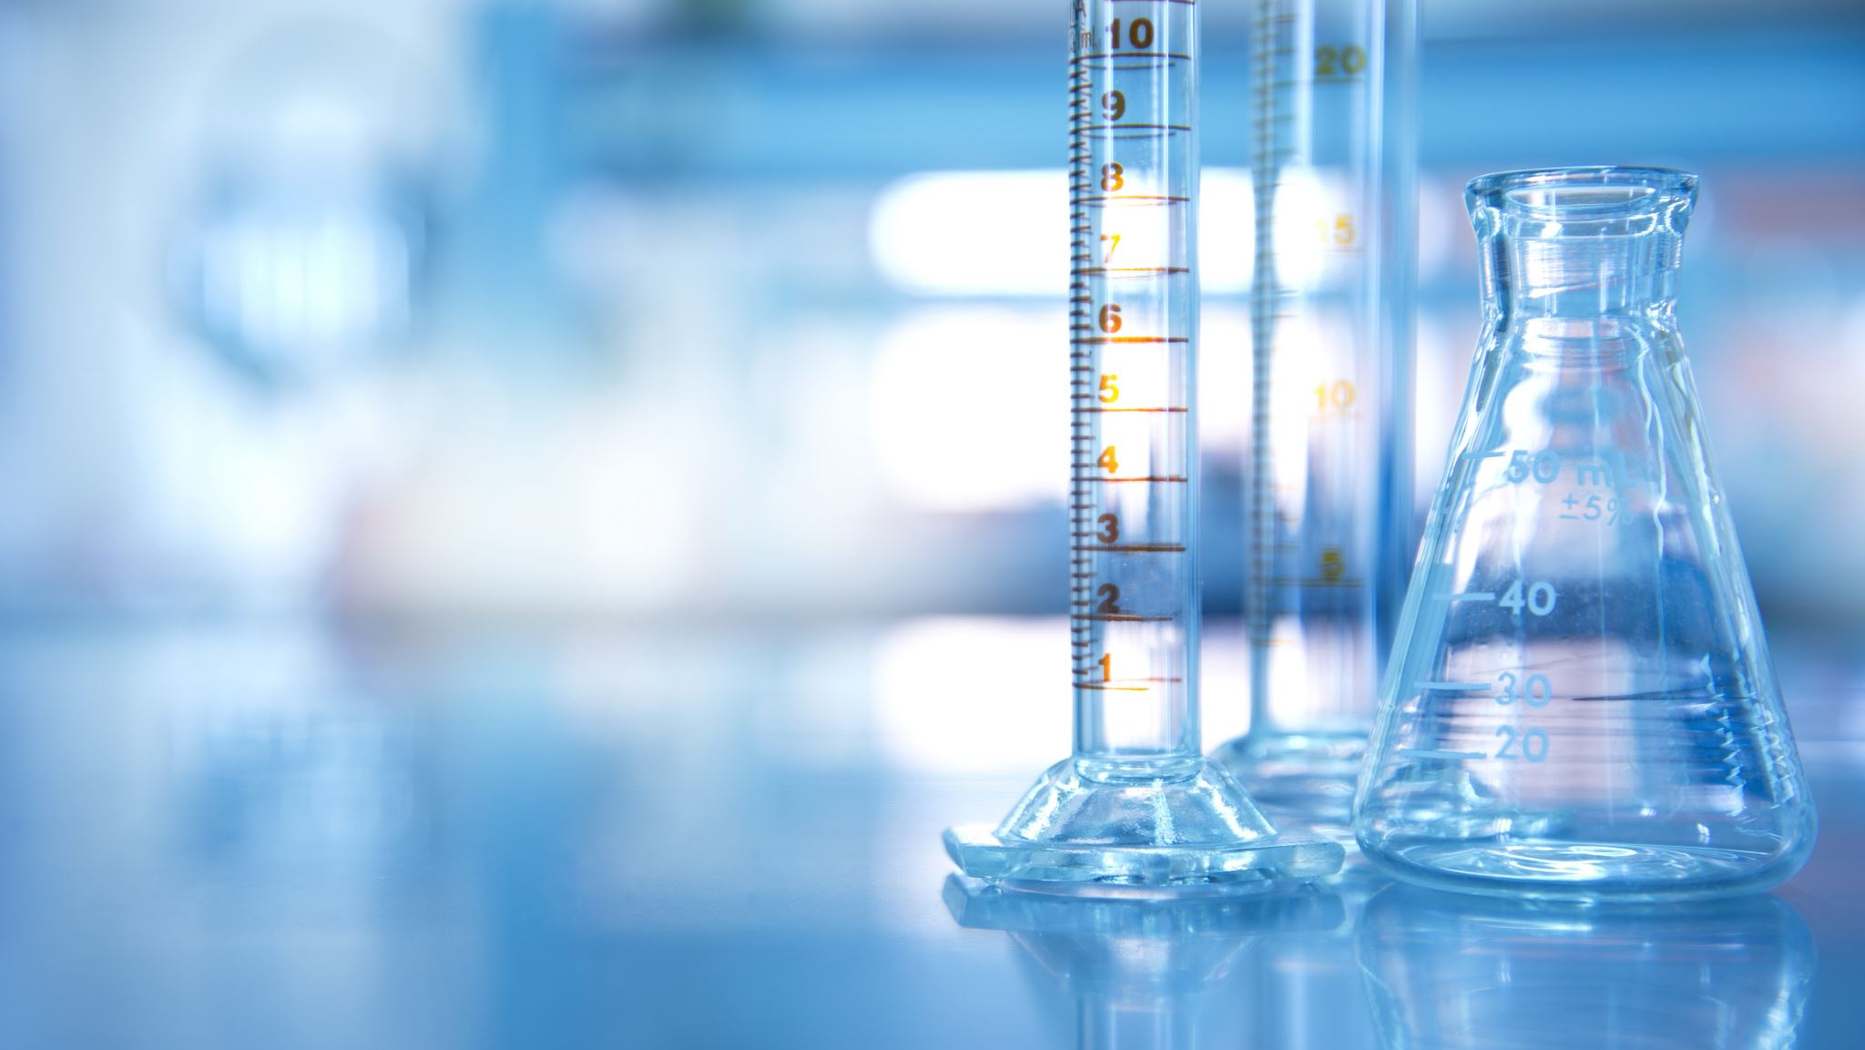
Abstract:
Arsenic pollution is a big problem in Bangladesh..
Drinking arsenic-mixed water for a long time can cause skin problems that can be easily seen..
In rural areas, there are very few skin doctors.
If the disease is found early, serious health damage can be avoided.
AI can help detect skin diseases automatically and quickly.

Slide 3
The Problem:
Long-term exposure causes visible skin diseases.
No easy and affordable diagnosis in rural areas.
Dependence on expert doctors.
Late detection leads to cancer and organ damage.
Need for an automated screening system.

Slide 4
Project Goals (Objectives)
Detect
Detect arsenic skin lesions using ML.
Compare
Compare different ML models.
Highlight
Highlight affected skin areas.
Provide
Provide medical guidance using chatbot
Build
Build a deployable web/mobile system.
Help
Help rural doctors detect arsenic problems faster.

Slide 5
What Others Have Done (Literature Review)
CNNs detect skin cancers accurately.
Chatbots help with symptoms, triage, and health tips.
Most studies don’t show exactly where the skin is affected or give advice..
Our project detects skin problems and advises.
Our project fills this research gap.

Slide 6
How the System Works (Methodology Overview)
Image preprocessing.
Lesion detection & highlighting
Classification using CNN.
Chatbot-based explanation.
Doctor referral recommendation.
Deployment: Build a simple graphical interface (GUI or web app).
Input Skin Image → Preprocessing → Feature Extraction → ML Model → Output (Normal / Arsenic Affected) → Medical Guidance

Slide 7
Tools and Technologies
Programming Language: Python
Libraries: TensorFlow, Keras, Scikit-learn, OpenCV
Framework: Flask or Tkinter (for interface)
Dataset: Medical and online arsenic skin image data
Evaluation Metrics: Accuracy, Precision, Recall, F1-score
Deployment (Planned): Flask / Streamlit

Slide 8
Expected Results
Accurate skin lesion detection.
Highlighted output images.
AI-powered chatbot assistant.
Automated medical referral.
Working prototype for demo.

Slide 9
Chatbot Integration
User uploads skin image.
System analyzes image.
Chatbot explains result simply.
Gives Preventive advice.
Suggests doctor if risk is high.

Slide 10
Future Work
Severity Levels: Detect mild, moderate, and severe skin problems, not just healthy/affected..
Chatbot Support: Add Bangla and English language support..
Find Nearby Hospitals: Suggest nearest doctors using GPS.
Offline App: Make a mobile app that works without internet.

Slide 11
Challenges
Image Quality: Difficult to get clear, consistent photos in remote villages.
Lighting and image quality can affect accuracy.
Doctor Shortage: Very few experts in rural areas to confirm results.
User Trust: Patients may doubt a machine without visual proof.

Slide 12
Conclusion
AI can bridge healthcare gaps.
Low-cost and scalable solution.
Strong impact on rural Bangladesh
Combines ML, vision, and chatbot.
Future improvements can make it more accurate and accessible.

